Slide 1
FLOATING-POINT DECIMAL NUMBER
123456.0 × 10⁻¹ = 12345.6 × 10⁰
= 1234.56 × 10¹
= 123.456 × 10²
= 12.3456 × 10³
= 1.23456 × 10⁴(normalised)
Three pieces of information represents a number:
Sign of the number
Significant value
Signed exponent of 10.
Example
The range of a fixed-point decimal system with six digits, of which two are after the decimal point, is 0.00 to 9999.99.
The range of a floating-point representation form m.mmm × 10^{ee} is 0.0 × 10⁰ to 9.999×10⁹⁹.

Slide 2
IN C PROGRAM
• Data of type float and double are represented as binary floating-point numbers.
• These are approximations of real numbers as
like an int, an approximation of integers.

Slide 3
IEEE NOTATION
IEEE Floating Point notation is the standard representation in use. There are two representations:
- Single precision.
- Double precision.
Both have an implied base of 2.
Single precision:
- 32 bits (23-bit mantissa, 8-bit exponent in excess-127 representation)
Double precision:
- 64 bits (52-bit mantissa, 11-bit exponent in excess-1023 representation)
Fractional mantissa, with an implied binary point at immediate left.
Sign Exponent Mantissa
1 8 or 11 23 or 52

Slide 4
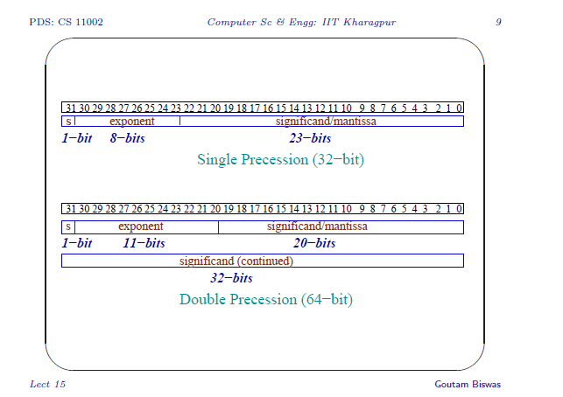
IEEE NOTATION

Slide 5
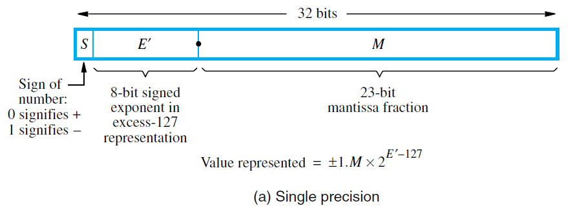
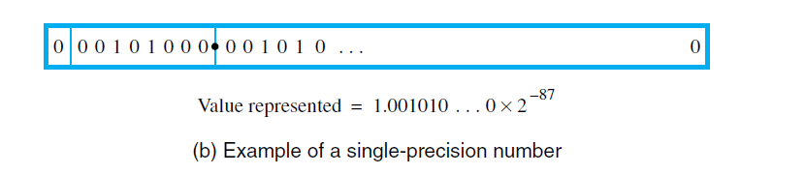
IEEE REPRESENTATION
Sign of the number is given in the first bit, followed by a representation of the exponent (to the base 2) of the scale factor.
In case of signed exponent, E , the value stored in the exponent field is an unsigned integer E ’ = E + 127

Slide 6
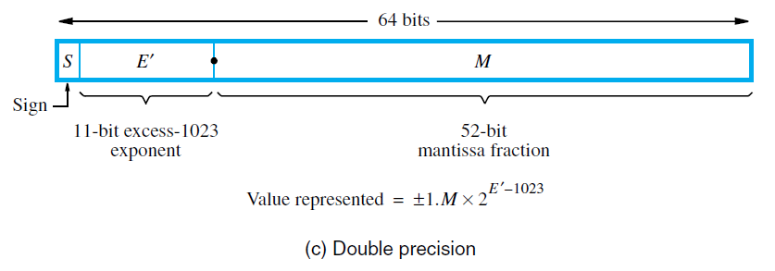
IEEE REPRESENTATION
Sign of the number is given in the first bit, followed by a representation of the exponent (to the base 2) of the scale factor.
In case of signed exponent, E , the value stored in the exponent field is an unsigned integer E ’ = E + 1023

Slide 7
IEEE REPRESENTATION
Floating point numbers have to be represented in a normalized form to maximize the use of available mantissa digits.
In a base-2 representation, this implies that the MSB of the mantissa is always equal to 1.
If every number is normalized, then the MSB of the mantissa is always 1.
IEEE notation assumes that all numbers are normalized so that the MSB of the mantissa is a 1 and does not store this bit.

Slide 8
An Example
Consider the following 32-bit pattern
1 1011 0110 011 0000 0000 0000 0000 0000
The value is
(−1)¹ × 2¹⁰¹¹⁰¹¹⁰⁻⁰¹¹¹¹¹¹¹ × 1.011
= −1.375 × 2⁵⁵

Slide 9
An Example
Consider the decimal number: +105.625.
The equivalent binary representation is :- +1101001.101
+ 1101001.101
= + 1.101001101 × 2⁶
= + 1.101001101 × 2¹³³⁻¹²⁷
= + 1.101001101 × 2¹⁰⁰⁰⁰¹⁰¹⁻⁰¹¹¹¹¹¹¹
In IEEE format:
0 1000 0101 101 0011 0100 0000 0000 0000

Slide 10
IEEE EXPONENT FIELD RANGE
In the IEEE representation, the exponent is in excess-127 (excess-1023) notation.
The actual exponents represented are:
-126 <= E <= 127 and -1022 <= E <= 1023
not
-127 <= E <= 128 and -1023 <= E <= 1024
This is because the IEEE uses the exponents -127 and 128 (and -1023 and 1024), that is the actual values 0 and 255 to represent special case.

Slide 11
IEEE REPRESENTATION Special Case
When E ’ = 0 (-127+127) and
Mantissa fraction (M) = 0 ,
then the value exact ZERO is represented.
2. When E ’ = 255 (-128+127) and
Mantissa fraction (M) = 0 ,
then the value is ∞ (infinity) represented.

Slide 12
IEEE REPRESENTATION Special Case
3. When E ’ = 0 (-127+127) and
Mantissa fraction (M) ≠ 0 ,
then value is represented as Denormal Number.
4. When E ’ = 255 (-128+127) and
Mantissa fraction (M) ≠ 0 ,
then value is represented as Not a Number (NaN).

